Slide 1



Résumé–Job Matching and
Talent-Marketplace Engine
Data Structures and Algorithms - 3 (25CS2103E) | A.Y. 2026-2027
Under the Guidance of
Submitted by:
Ms. K. Chandusha
S. Svara Haasini (2520090170)
B. Sudharshini (2520090227)
KLH (Deemed to be University) | Section: 10

Slide 2






Abstract
Efficiency
Intelligence
Optimization
Automates the manual, inconsistent process of reviewing large résumé volumes to speed up hiring cycles.
Normalizes terms (e.g., "ML" vs "Machine Learning") to ensure semantic matching and compatibility scoring.
Uses graph matching and set-cover algorithms for optimal candidate assignment and team formation.
Final system provides ranked recommendations, skill-gap analysis, and transparent matching explanations.

Slide 3


Introduction
The Hiring Challenge
Traditional methods are slow and labor-intensive.
Human bias often leads to inconsistent candidate screening.
Scalability is limited when handling thousands of applicants.
Proposed Solution
A data-driven engine that indexes documents, extracts core competencies, and mathematically calculates the "best fit" for any role or organizational project.

Slide 4
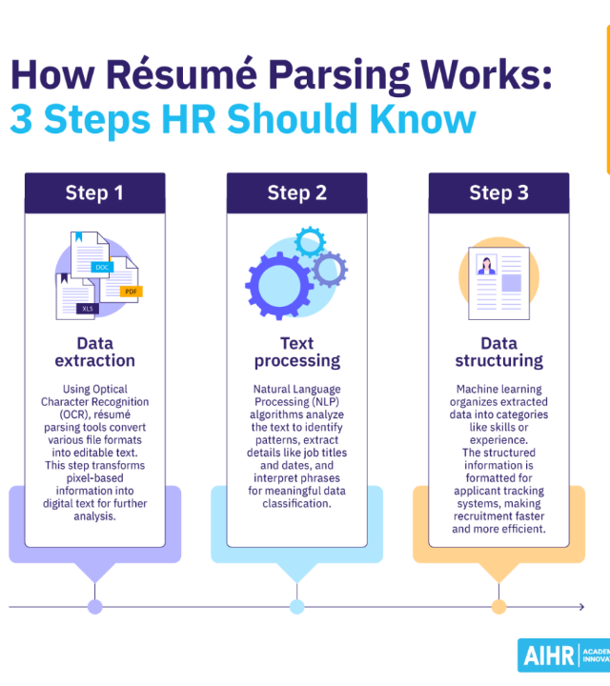
Methodology
Phase 1: Information Extraction
The system indexes both résumés and job descriptions using Inverted Indexes for rapid retrieval.
Semantic Normalization: Different terms (ML, Machine Learning, Predictive Modeling) are mapped to a unified taxonomy using string-matching and hash-map lookups.
This ensures that candidates aren't penalized for specific phrasing, focusing on actual competency instead.

Slide 5

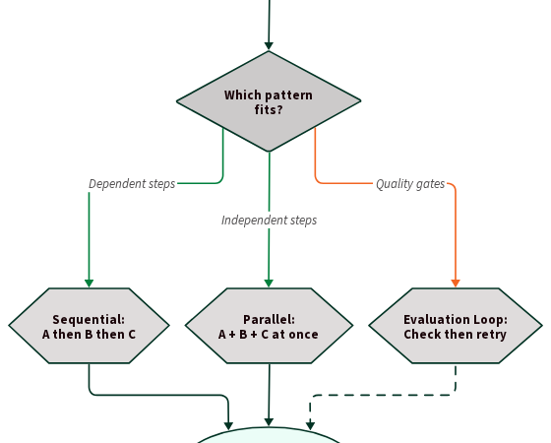
Methodology
Phase 2: Compatibility Analysis
Compatibility Score: Calculation of similarity between skill sets, experience level, and role requirements.
Priority Queues: Used to maintain a live ranking of candidates based on their dynamic relevance scores.
Transparency: The engine provides explanations for why a match was made, identifying specific overlaps.

Slide 6



Literature Survey
Gen 1: Boolean
Gen 2: Vector Space
Current: Semantic
Simple keyword search. Discarded highly qualified candidates if exact phrasing was missing (e.g., missed "JS" for "JavaScript").
Used TF-IDF and Cosine Similarity. Better at catching topical relevance but struggled with context.
Modern NLP and Inverted Indexing. Focus on talent marketplace optimal assignment and group formation.

Slide 7
Software Requirements
Category | Required Software / Tool
Programming Language | Python 3.10+ (Primary engine logic)
NLP Libraries | SpaCy, NLTK (Tokenization, Lemmatization)
Data Structures | Custom Implementations (Hash Maps, Inverted Indexes, Priority Queues)
Database | SQLite or MongoDB (Storing indexed profiles)
IDE | Visual Studio Code / PyCharm

Slide 8


Hardware Requirements
Processor: Multi-core CPU (Intel i5/i7 or AMD Ryzen 5+) for parallel parsing.
Memory: 8GB RAM minimum (16GB recommended for large index processing).
Scalability Note
Storage: 256GB SSD (Fast I/O for inverted index lookups).
For production-scale deployment, the system can be hosted on AWS/Azure to utilize elastic compute for peak application periods.
Display: Standard Full HD (1920x1080) for interface testing.

Slide 9

Talent Marketplace
Optimal Role Assignment
The engine prevents "Double Allocation" by using graph-matching algorithms to assign candidates to multiple roles efficiently.
Project Team Formation
Identifies the Minimum Set Cover of skills required to form a high-performing project team.
Goal: Ensuring every required project skill is covered by the smallest, most efficient group of candidates.

Slide 10
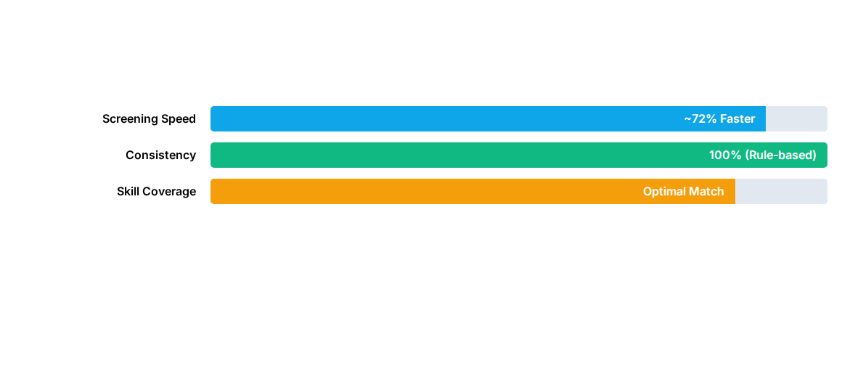
System Performance Analysis
The system significantly reduces the "Time-to-Hire" metric compared to manual screening.

Slide 11



Future Scope & Outcomes
Predictive Analytics
Bias Mitigation
Multilingual Support
Matching candidates to "Success Profiles" based on historical performance data.
Implementation of "Blind Screening" modes to hide sensitive demographic data.
Extending the matching logic to global résumé formats and languages.

Slide 12


Thank You
Questions & Answers
Résumé–Job Matching and Talent-Marketplace Engine
KLH Bachupally | Team 10

Slide 13




Image Sources
https://png.pngtree.com/thumb_back/fh260/background/20241014/pngtree-modern-business-office-interior-background-blurred-space-for-corporate-use-contemporary-image_16359815.jpg
Source: pngtree.com
https://www.aihr.com/wp-content/uploads/resume-parsing-Blog-1024x1024.png
Source: www.aihr.com
https://tallyfy.com/blog-images/diagrams/workflow-patterns-ai-agents-patterns-1.svg
Source: tallyfy.com
https://media.deloitte.com/is/image/deloitte/6791_banner-1:425-x-425?$Responsive$&fmt=webp&fit=stretch,1&wid=425&hei=425&dpr=off
Source: www.deloitte.com

